Slide 1

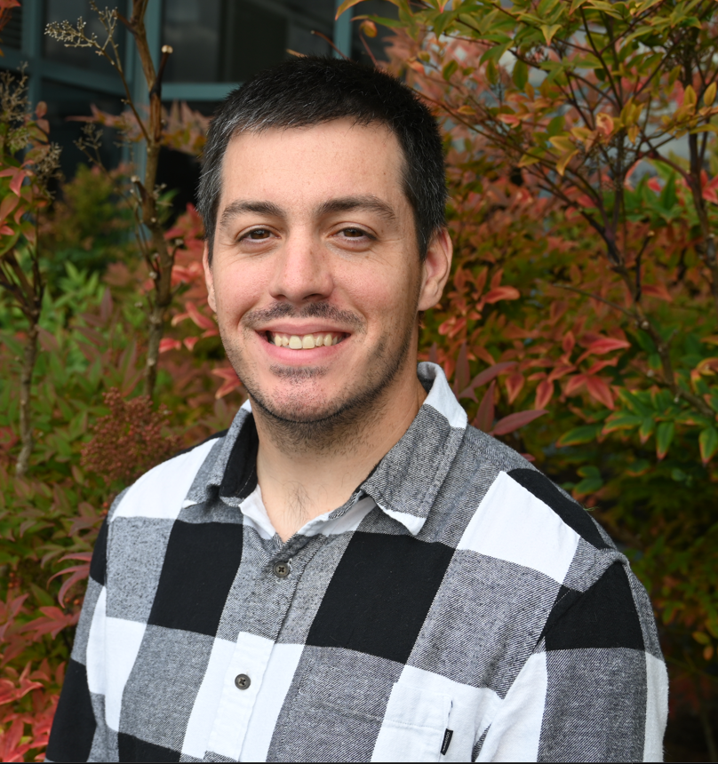







Professional Statement
As a highly motivated and result-oriented professional, I am eager to contribute my experience to an organization that values innovation, professional development, and teamwork. Throughout my years in Sales and Marketing, and in the United States Army, I have developed a reputation for being a problem-solver and an effective communicator. I have experience leading teams and coordinating tasks to ensure successful outcomes. My communication skills allow me to effectively interact with colleagues, vendors, and customers to ensure projects are completed on time. I am confident that my passion and dedication to excellence will make me a valuable asset to any team. I believe my skills will help make a seamless transition into the IT field, where I can satisfy customer and company needs.
Dean Wilcox
Cloud Application Development
Career Areas
of Interest
Education
Additional Skills
Software Engineer
Intelligence Analyst
Data Analyst
Cloud Software Developer
Principal AI Engineer
St. Martin’s University – Bachelor of Computer Science (Completion 2025)
Washington Vets 2 Tech Student – Cloud Application Development
Familiar with Python, HTML, CSS, JavaScript, Java, and the Linux OS
Solutions Oriented professional
Effective cross functional communicator
Rapid and adaptive
Sales enthusiast
Manager/Supervisor experience
Information for Employers
Preferred location(s): Washington State
Willing to relocate: Yes
Open to remote: Yes
Military Background: 91B Wheeled Vehicle Mechanic
Security Clearance: Secret
Security Clearance expiration: Continuous
Certifications
Projects/
Experience
Interests/Hobbies
Contact Information
Phone: 832-573-7963
Email: Wilcox.dean93@gmail.com
LinkedIn: Dean’s LinkedIn
Location: Lacey, WA
GitHub projects:
Running
Learning new skills
Meeting new people
Artificial Intelligence

Slide 2




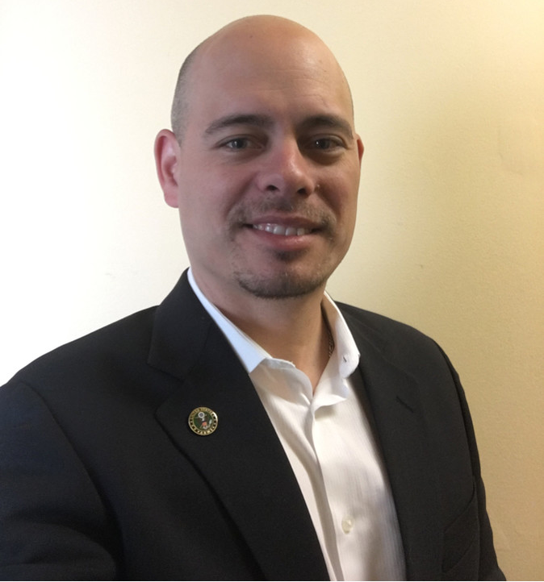
Armed Forces Branches
Photo
Don’t resize, just Right click then change the picture
Then copy and past on to your slide

